Slide 1



V
Apr 10, 2025
My Weekly
Updates
Song-Ze, Yu

Slide 2
01
Basic system design
Quickly
Rewinds
02
Implementation
Vaclis AI based Tone Replication plugins
03
Current progress

Slide 3
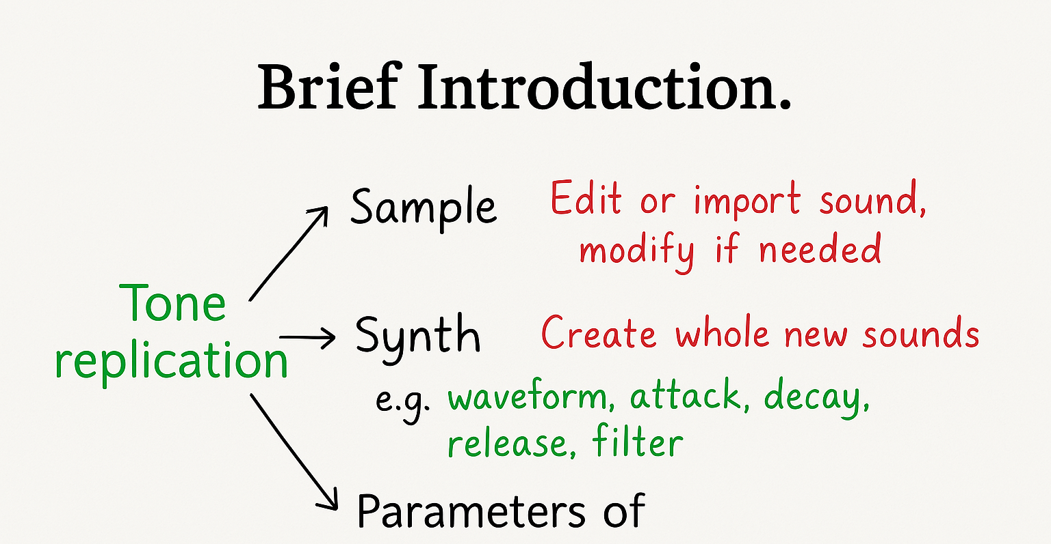

Slide 4
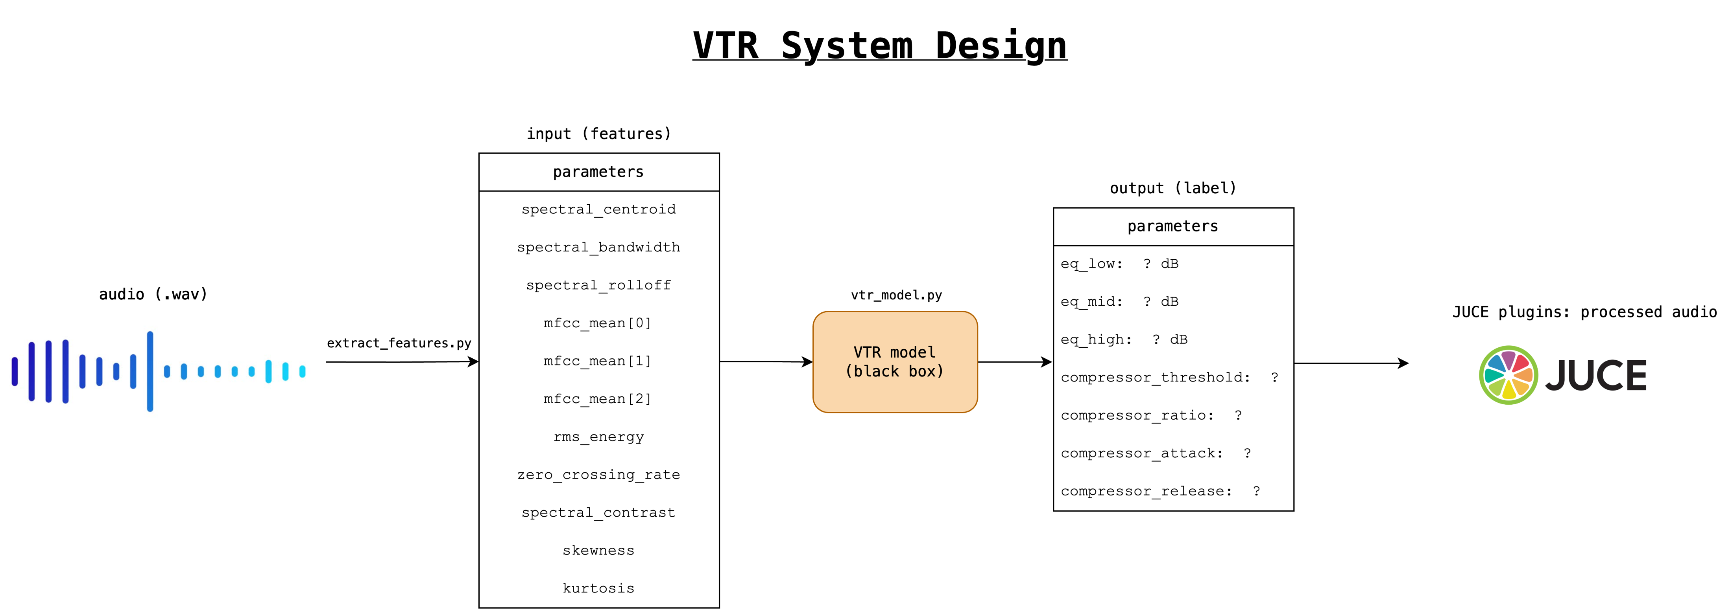

Slide 5
VTR System Workflow
1. Dataset making
2. Extract features (e.g., spectral centroid, MFCC): model input
3. Attach label (EQ and compressor parameter): model output and ground truth
4. Model training / inference: regression/SVM and classification first, NN if available
5. Evaluate tone recognition performance
6. Write the JUCE interface if available

Slide 7
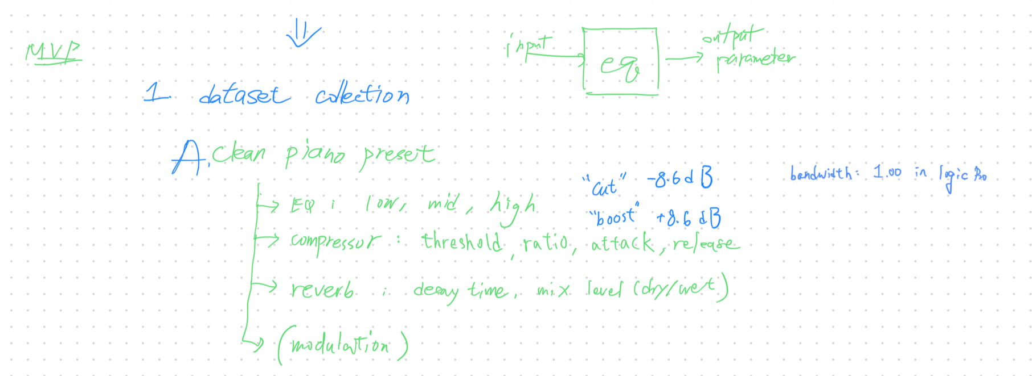
MVP Architecture
Create my own dataset
Goal: 500 samples

Slide 8
Progress: Dataset generating

Slide 9
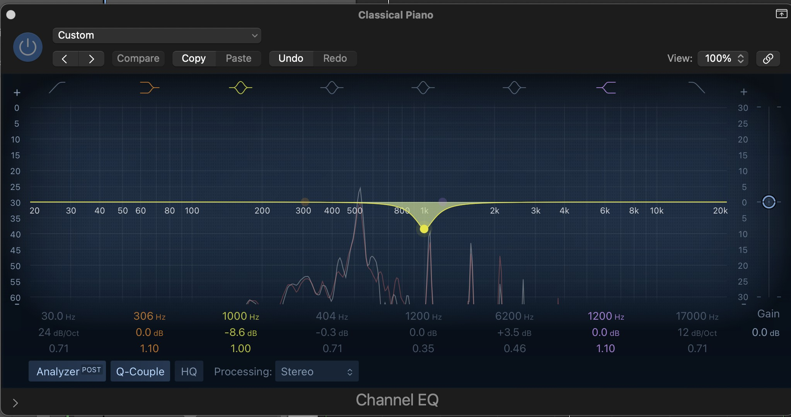
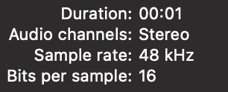

Slide 10
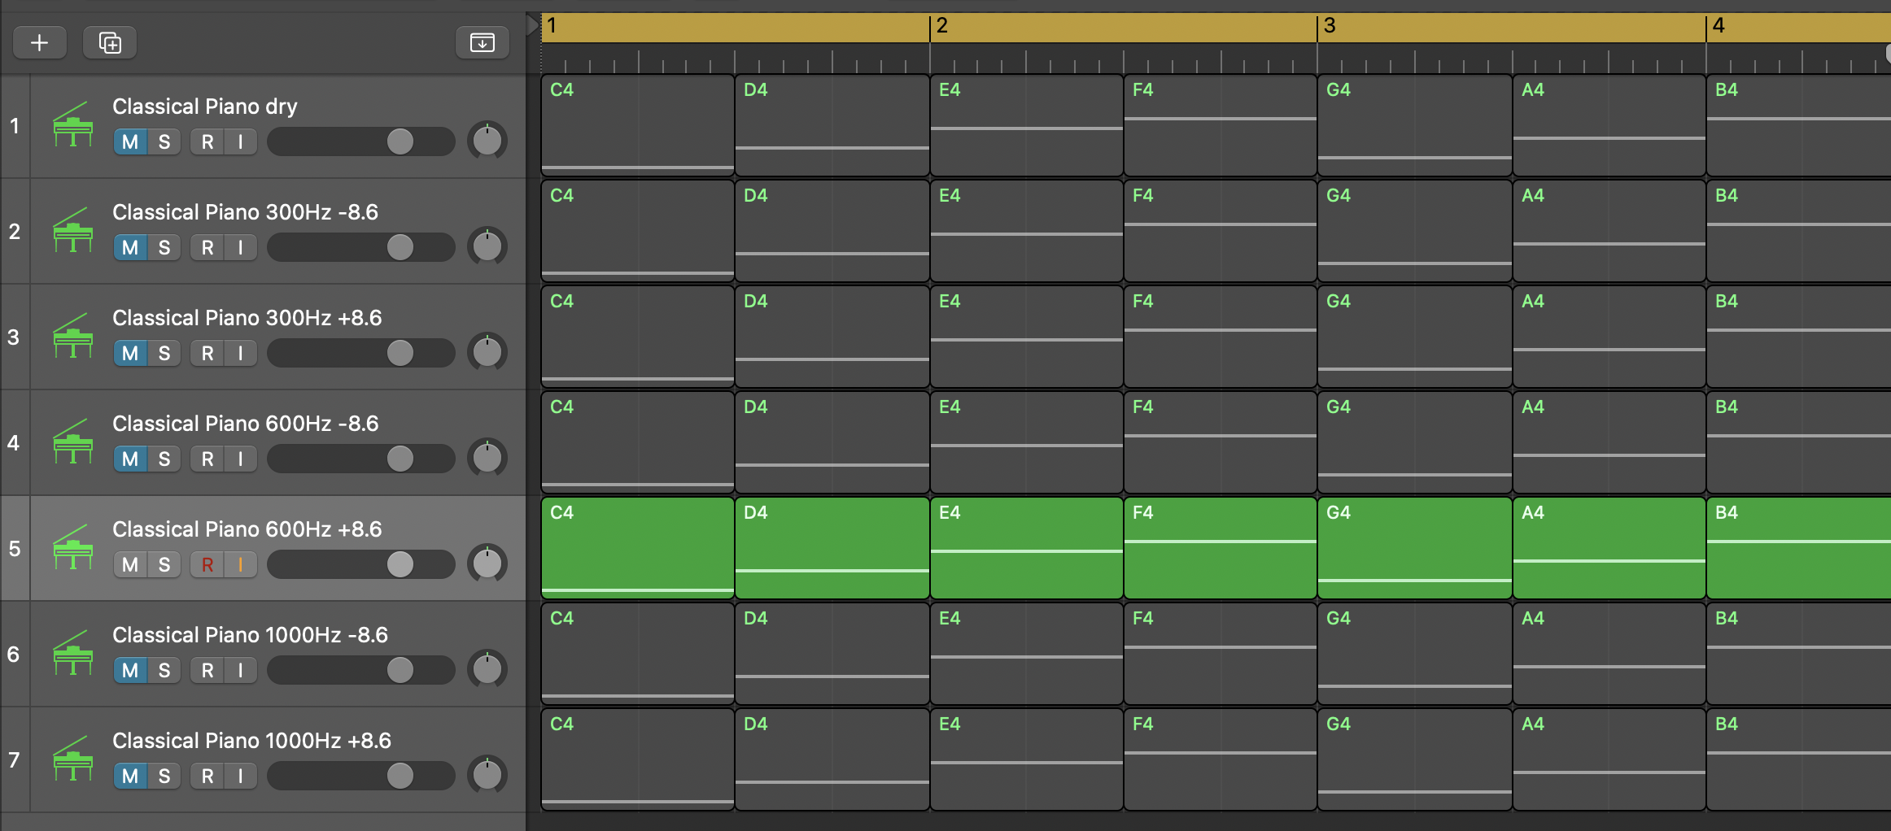

Slide 11
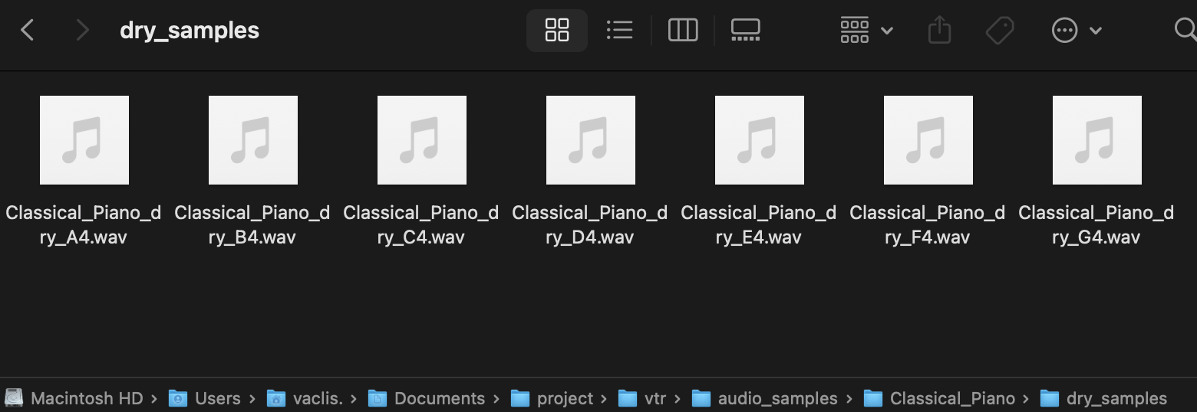
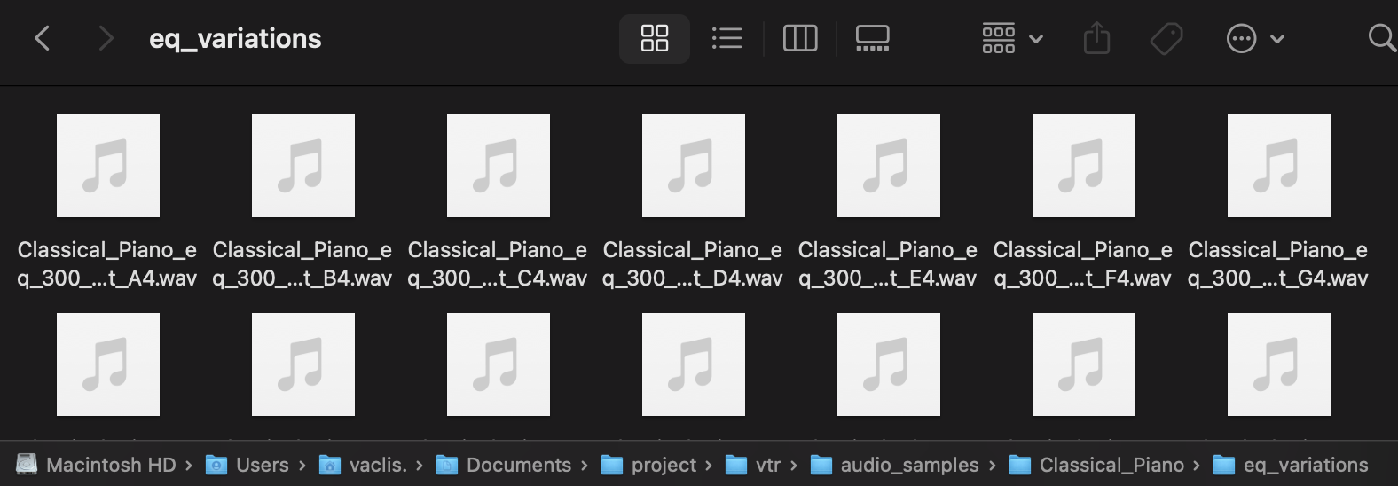

Slide 12
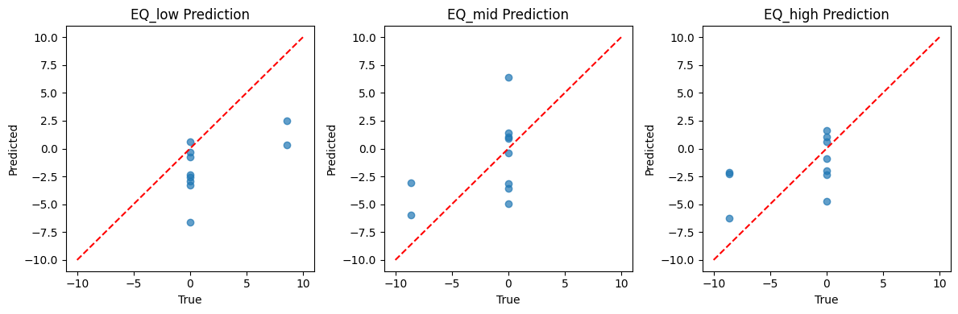
Progress: Model implementation (Regression)

Slide 13
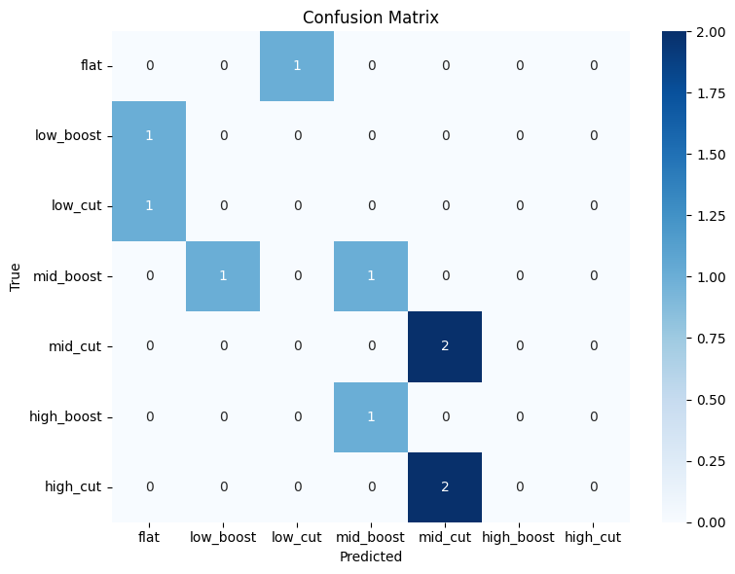
Progress: Model implementation (Classification)

Slide 14

V
Thank you!
Now, what’s next?

